Slide 1



Class2
NCL programming & Graphics (I)
Date : 2023 / 03 / 02
Speaker : Wan-Li, Tsai

Slide 2

Course Outline
(I)
03/02
Graphics
File I/O
(II)
03/09

Slide 3
Path
/data/course/2023_NCL_course/TA/0302_class2

Slide 4
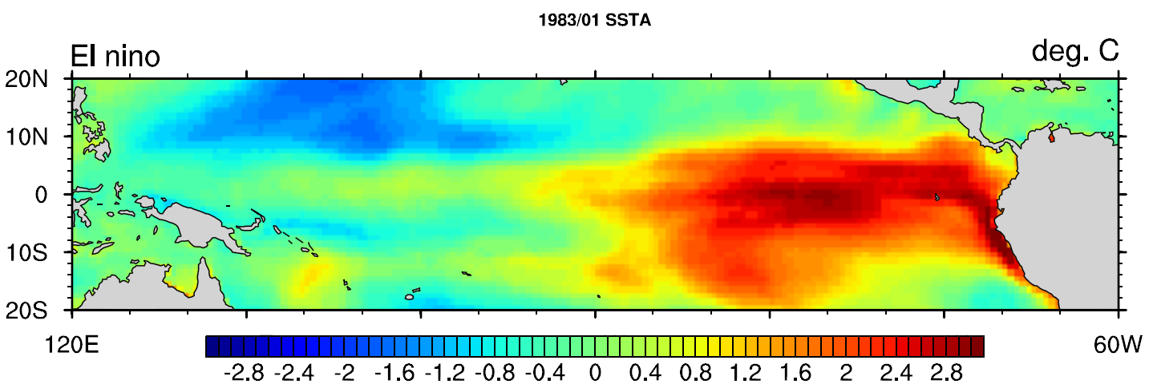
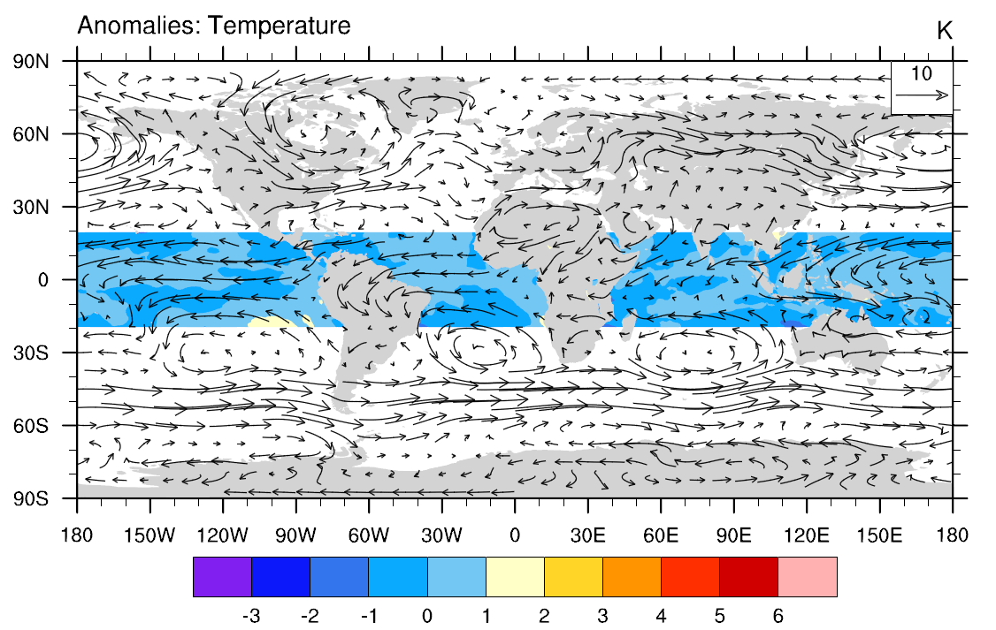
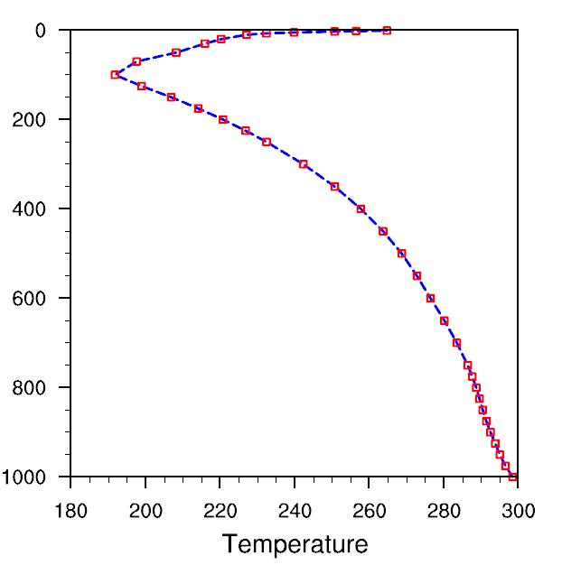
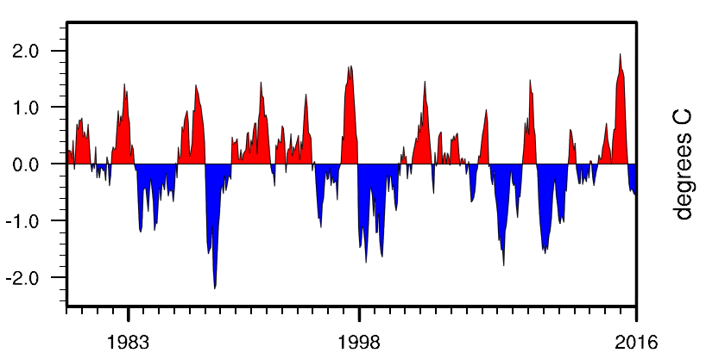
Basic plot types
2D contour map
2D vector map
Vertical profile
Time series
Panel (attach plots)
Scatter plots
Basic plot skills
wks setting
res (resources)
named color & table
add_poly…
Overlay plots
Font adjustment

Slide 5
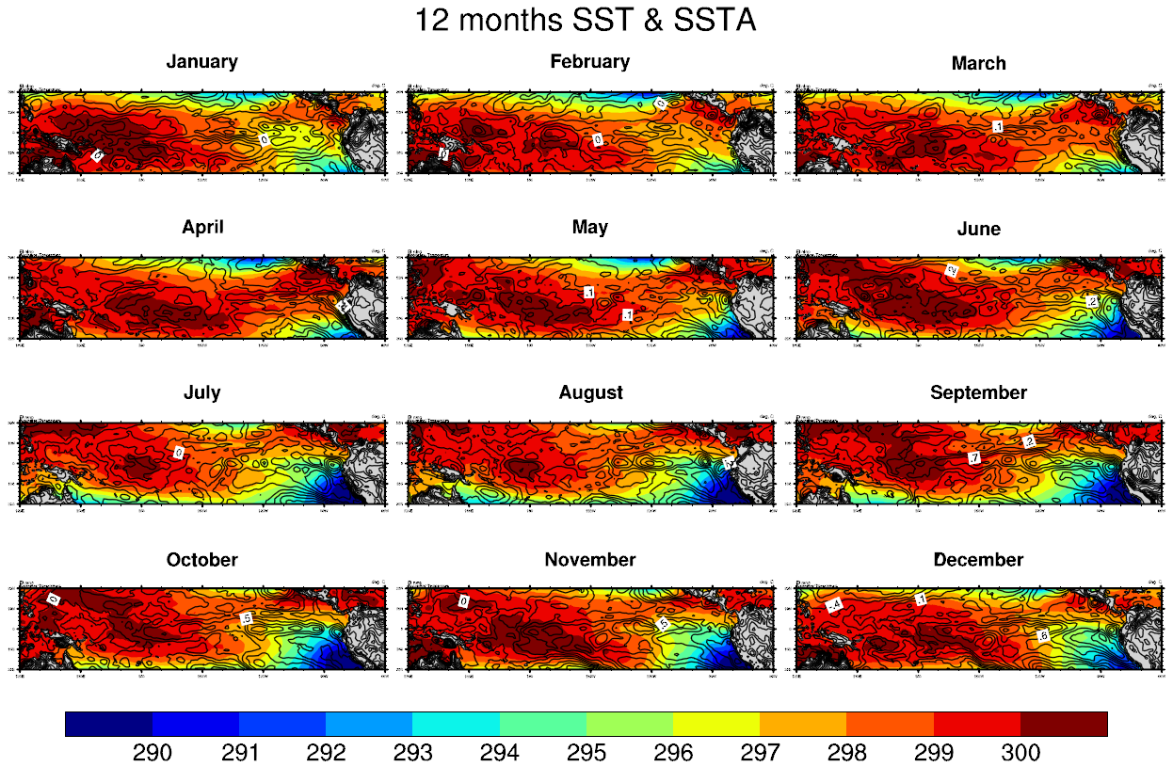
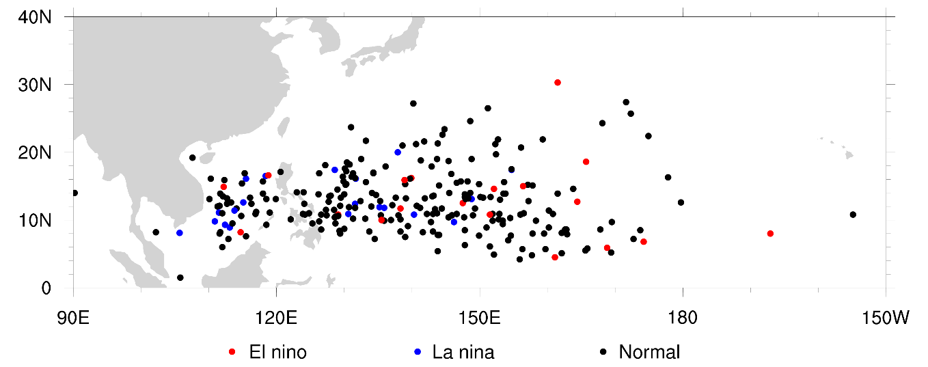
Basic plot types
2D contour map
2D vector map
Vertical profile
Time series
Panel (attach plots)
Scatter plots
Basic plot skills
wks setting
res (resources)
named color & table
add_poly…
Overlay plots
Font adjustment

Slide 6
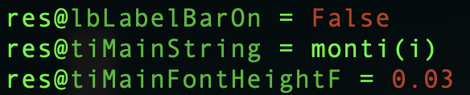
Basic plot skills - res (resources)
F
On
String
(Float)
True/False (logical)
“(String)”
res@ + resources + Substring1 + Substring2 + … + + =
am：annotation manager | cn：contour | ca：coordinate arrays
gs：graphical style | lb：label bar | lg：legend
mp：maps | pm：plot manager | pr：primitive
sf：scalar field | st：streamlines | ti：title
tm：tickmark | tx：text | tr：transform
vf：vector field | vc：vector plot | vp：view port
wk：workstation | ws：workspace | xy：xy plot

Slide 7
Practice 01
vector
ERA-Interim wind and temperature fields

Slide 8
2D vector map
vi 02-1_graphic_vector.ncl
path: /data/course/ERA-Interim/Monthly/0.5x0.5/Global/
variable: zonal wind(U), meridional wind(V), temperature(T)
be careful with the types!
Functions you need:
open data
converts the time to UT-referenced data
addfile(path,status)
cd_calendar(time,option)
option = -1 → YYYYMM
“r”: read
“c”: create

Slide 9
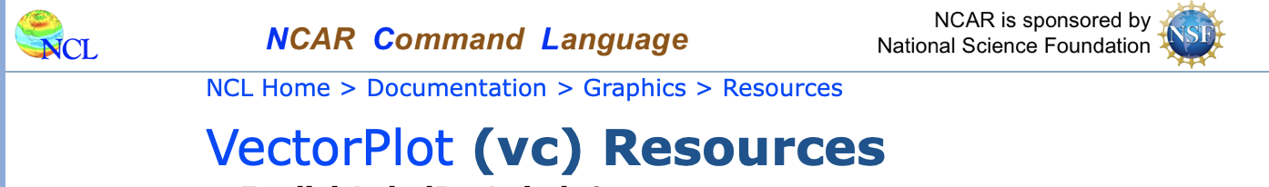
2D vector map
Functions you need:
“png”
open workstation
“pdf”
gsn_open_wks(type,name)
res@
plot
gsn_csm_vector_map(wks,u,v,res)
gsn_csm_vector_scalar_map(wks,u,v,data,res)
gsn_csm_streamline_map(wks,u,v,res)
gsn_csm_streamline_scalar_map(wks,u,v,data,res)

Slide 10
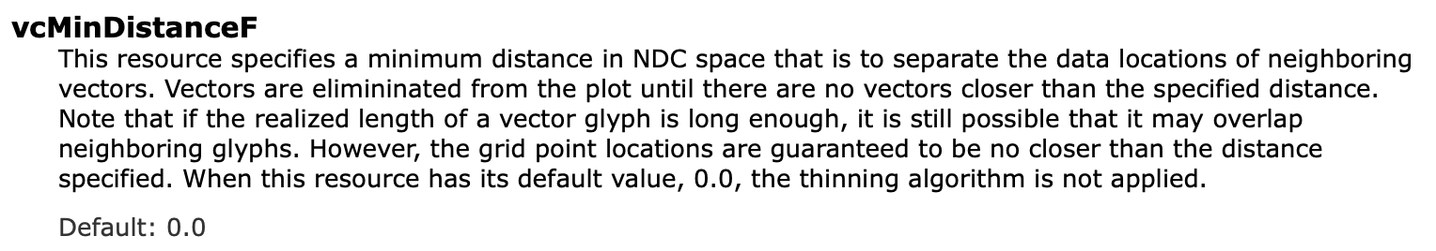
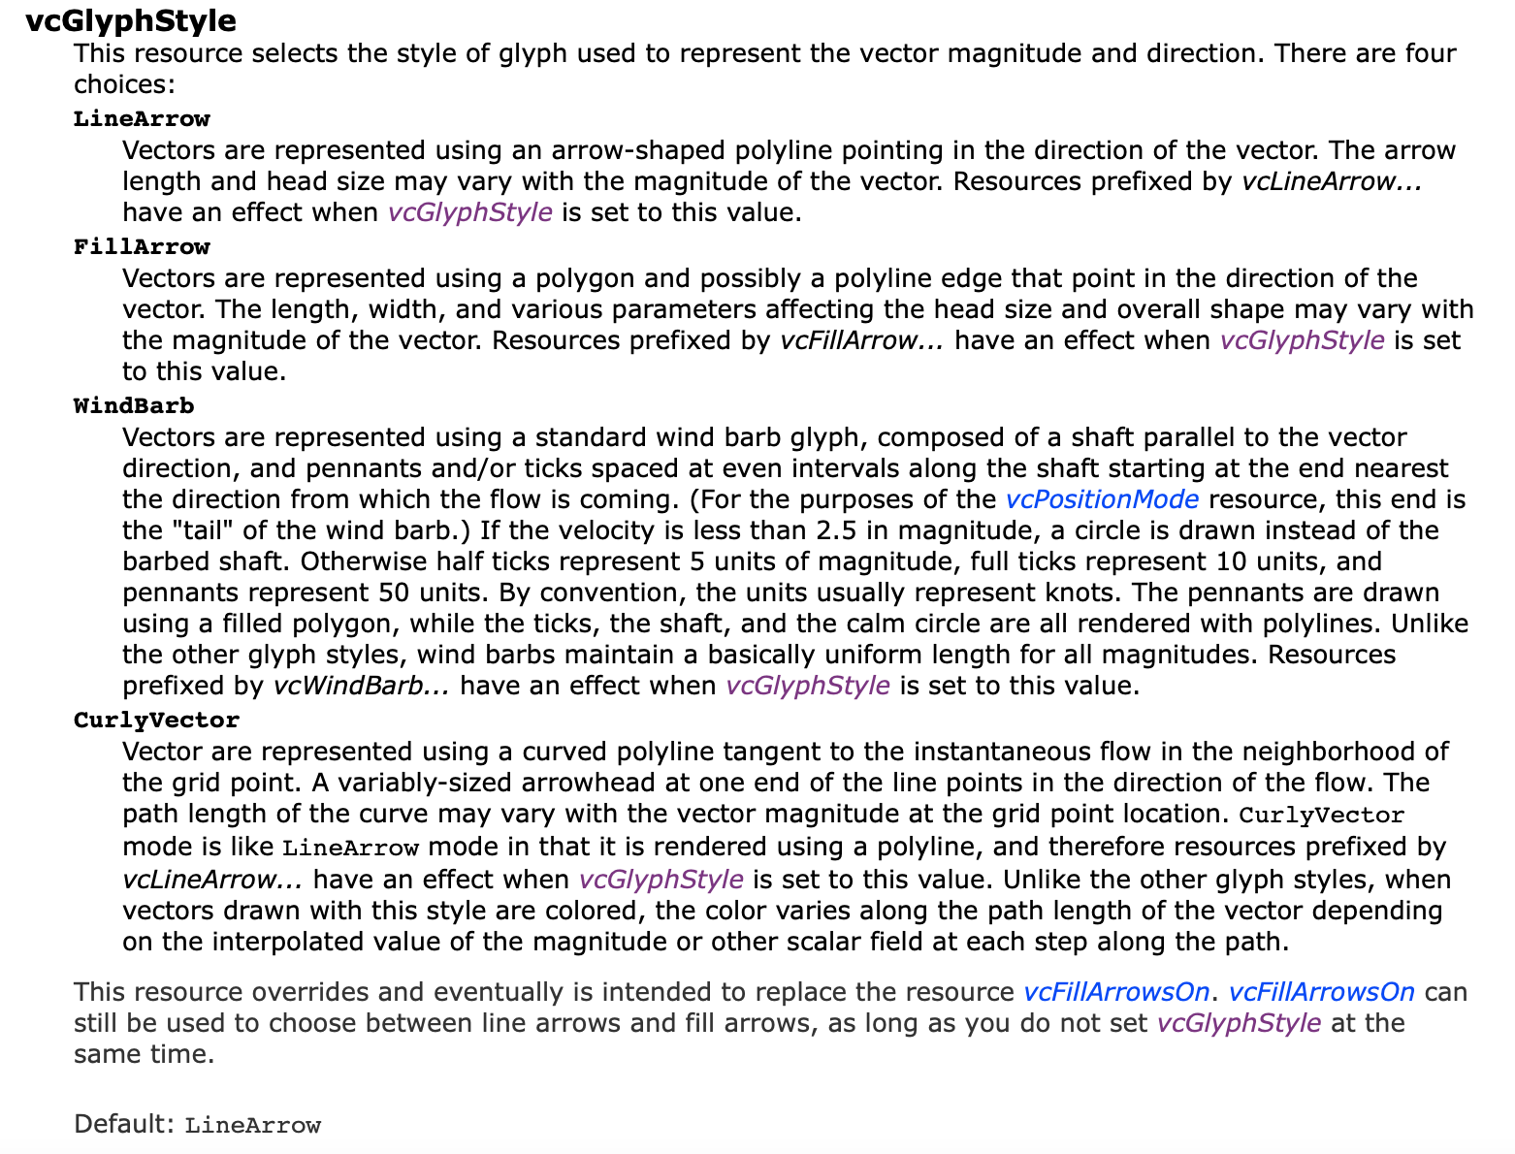
2D vector map
Resources you may need:

Slide 11
Practice 02
overlay
ERA-Interim SSTA and TA fields

Slide 12
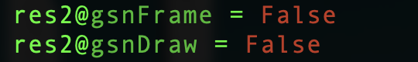
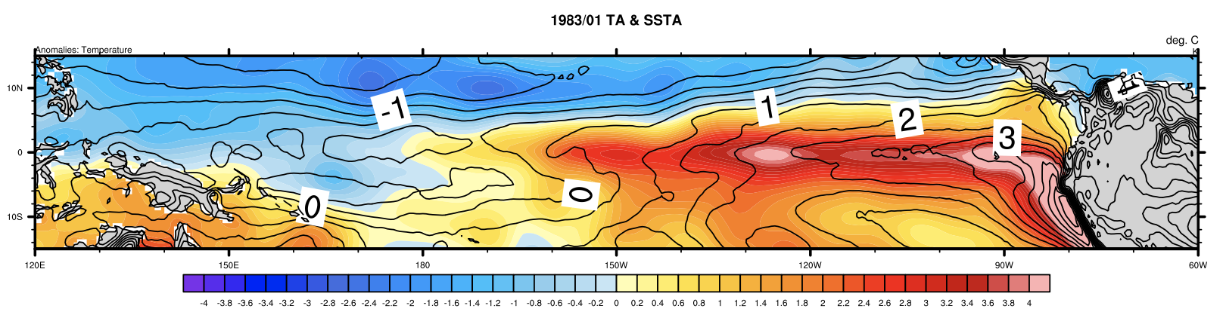
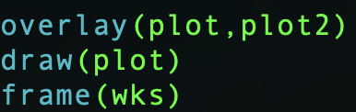
Overlay
vi 02-2_graphic_overlay.ncl
path: /data/course/ERA-Interim/Monthly/0.5x0.5/Global/
variable: temperature(T), sea surface temperature(SST)
Functions you need:
Overlays one plot object on another.
overlay(base_plot,transform_plot)
plot2
don’t draw
don’t turn on page
plot

Slide 13
Practice 03
panel
ERA-Interim 12 month pre_anom

Slide 14
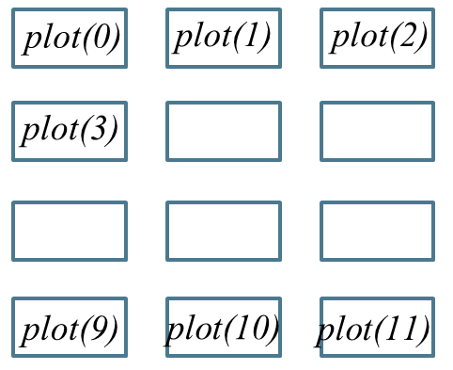
Panel
vi 02-3_graphic_panel.ncl
path: /data/course/ERA-Interim/Monthly/0.5x0.5/Inter-tropical/
variable: precipitation(pre_T)
Functions you need:
Draws multiple plots of identical size on a single frame.
gsn_panel(wks,plots,dims,res)
new(dimsizes_sizes,type)
Ex: plot = new(12,graphic)
…
gsn_panel(wks,plot, (/4,3/) ,resP)
row
column

Slide 15
Practice 04
gif.
ERA-Interim 1983 TA & SSTA

Slide 16
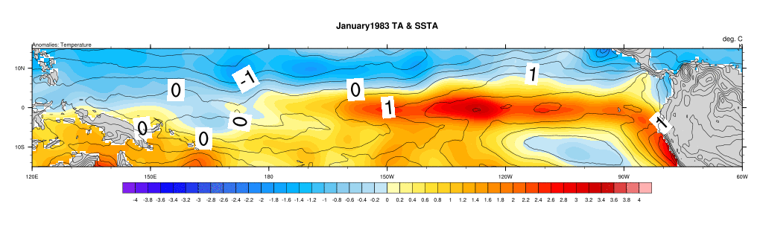
gif.
vi 02-4_graphic_gif.ncl
path: /data/course/ERA-Interim/Monthly/0.5x0.5/Global/
variable: temperature(T), sea surface temperature(SST)
Functions you need:
Executes a shell command
system(command)
convert –delay 30 figure.png figure.gif
delay specifies the time in milliseconds how fast the animation will change a frame

Slide 17
Practice 05
vertical profile
ERA-Interim temperature profile

Slide 18
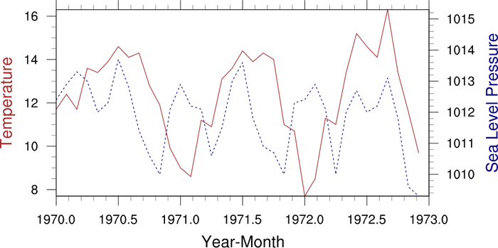
Vertical profile
vi 02-5_graphic_verticalprofile.ncl
path: /data/course/ERA-Interim/Monthly/0.5x0.5/Global/
variable: temperature(T)
Functions you need:
Creates and draws an XY plot
gsn_csm_xy(wks,x,y,res)
Creates and draws an XY plot with two different Y axes.
gsn_csm_xy2(wks,x,y1,y2,res)
Creates and draws an XY plot with two different X axes.
gsn_csm_x2y(wks,x1,x2,y,res)

Slide 19
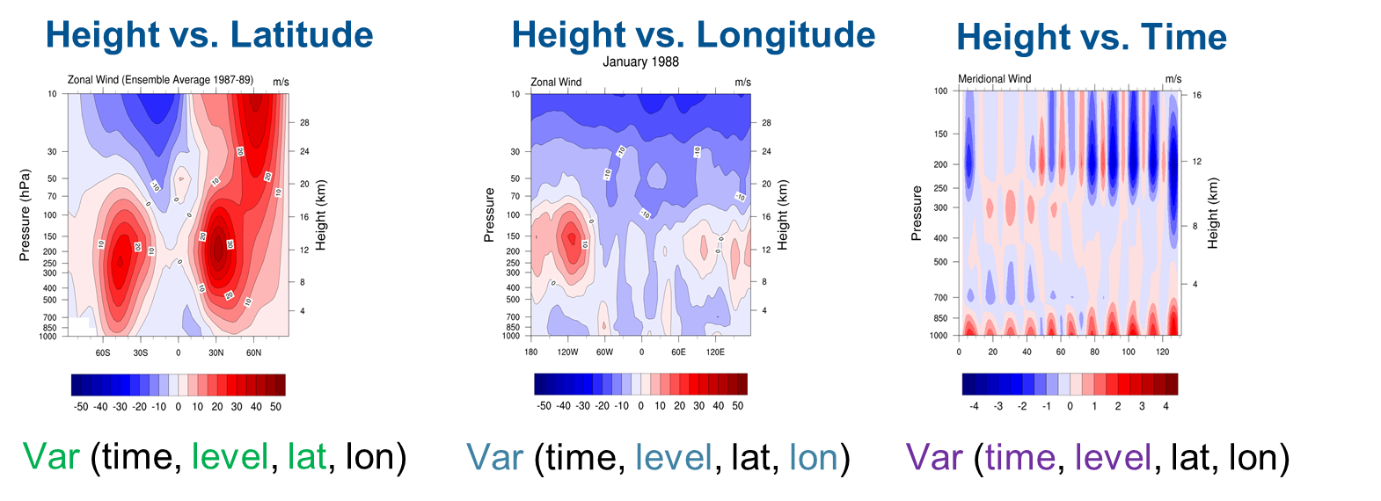
Vertical profile
Reference: https://www.ncl.ucar.edu/Applications/height_lat.shtml

Slide 20
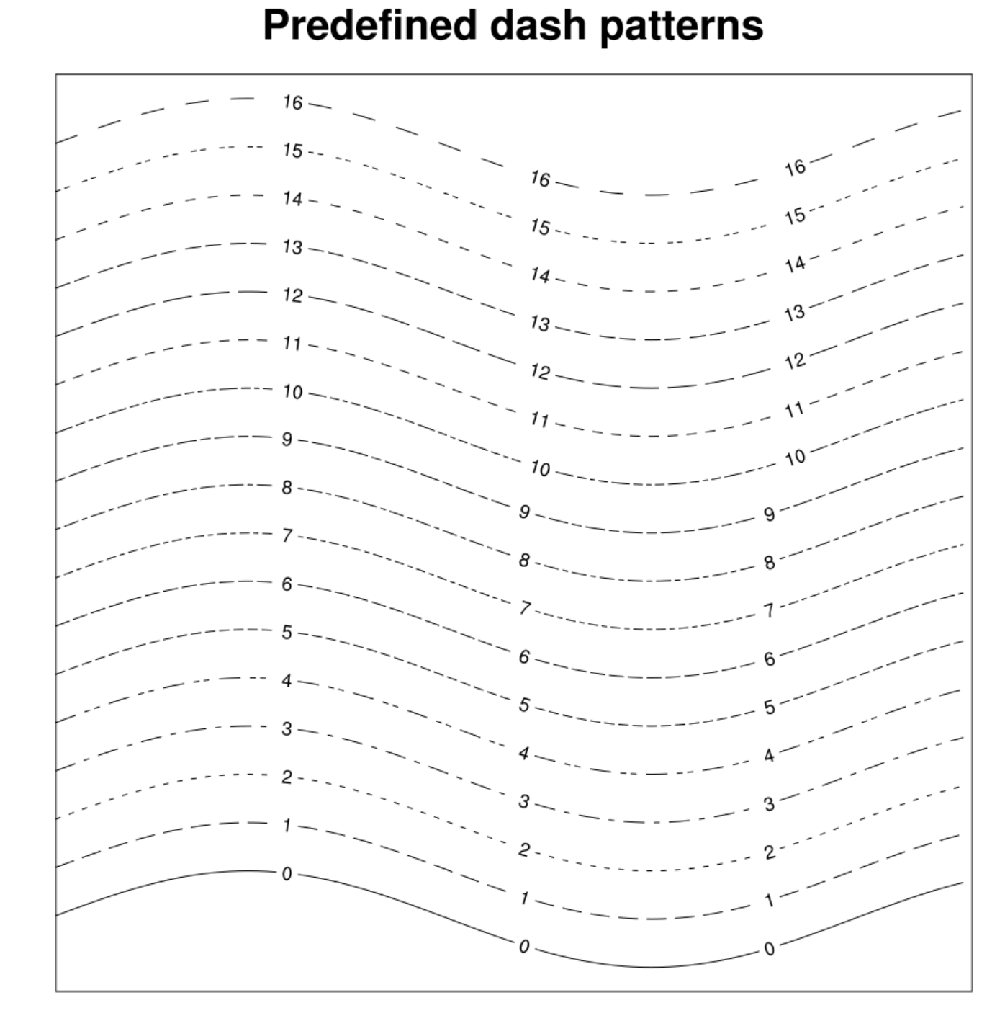
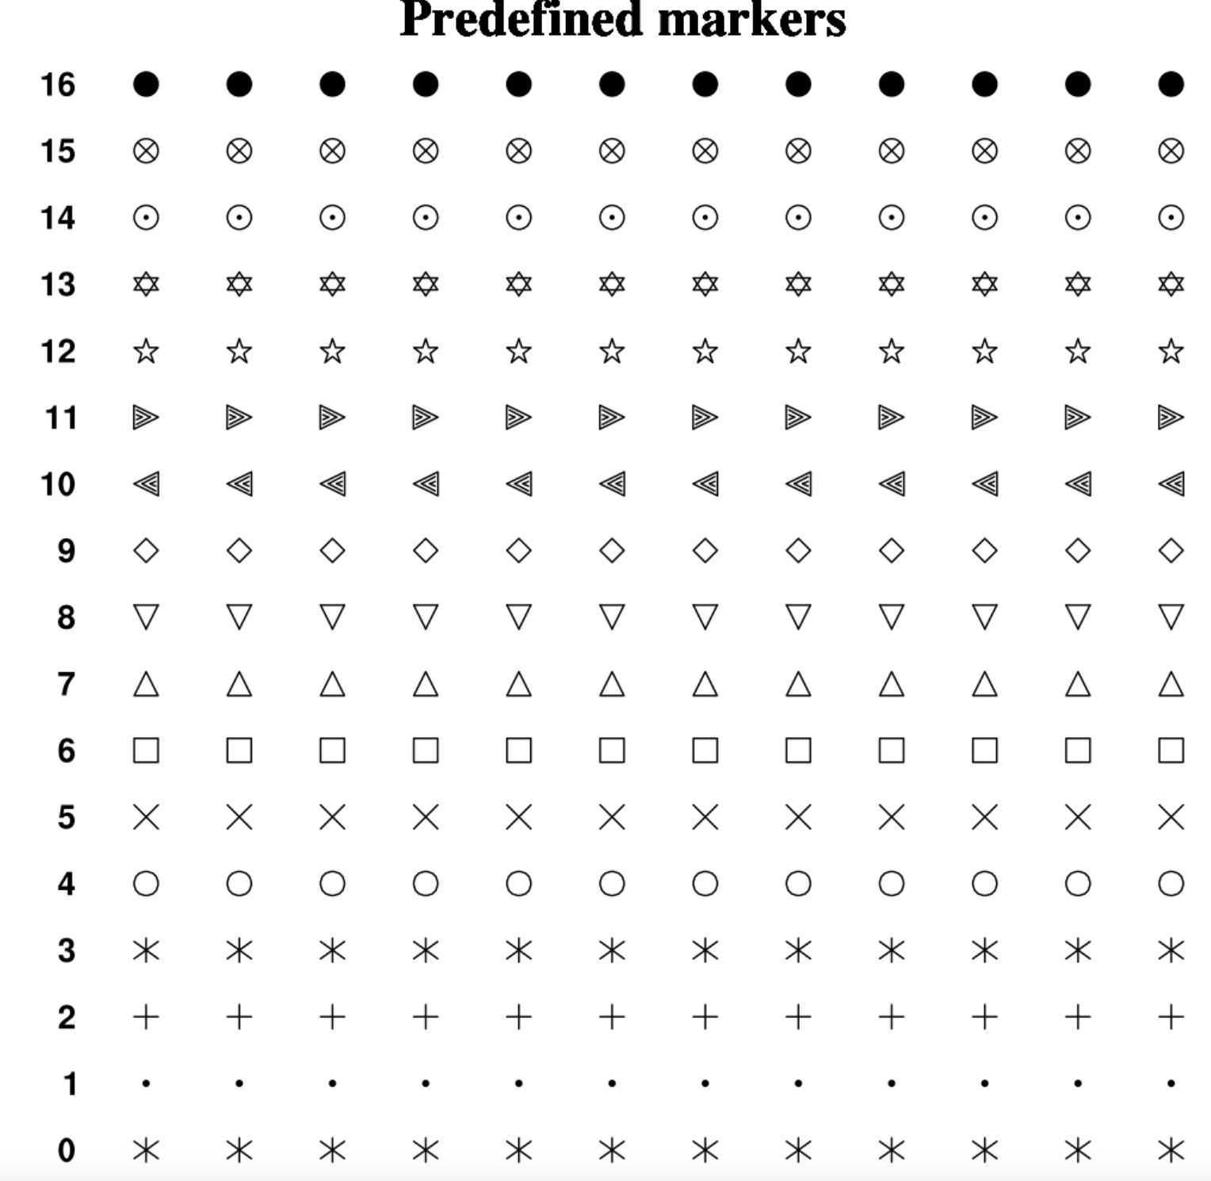
Vertical profile
https://www.ncl.ucar.edu/Document/Graphics/Images/dashpatterns.png
https://www.ncl.ucar.edu/Document/Graphics/Images/markers.png

Slide 21
Practice 06
time series
ERA-Interim SSTA time series

Slide 22
Time series
vi 02-6_graphic_timeseries.ncl
path: /data/course/ERA-Interim/Monthly/0.5x0.5/Global/
variable: sea surface temperature(SST)
Functions you need:
Index
Creates and draws an XY plot
gsn_csm_xy(wks,x,y,res)
Time
Attaches a polyline to the given plot
Index
gsn_add_polyline(wks,x,y,res)
Time

Slide 23
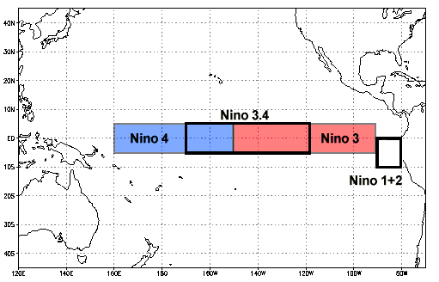
Time series
Time series: Niño 3.4 index
Computes the average of a variable’s given dimensions
dim_avg_n_Wrap(var,dims)
Ex:SSTA(time,lat,lon)
dim_avg_n_Wrap(SSTA,(/1,2/))

Slide 24
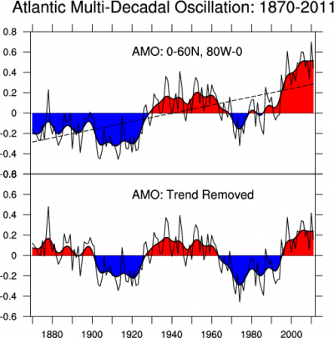
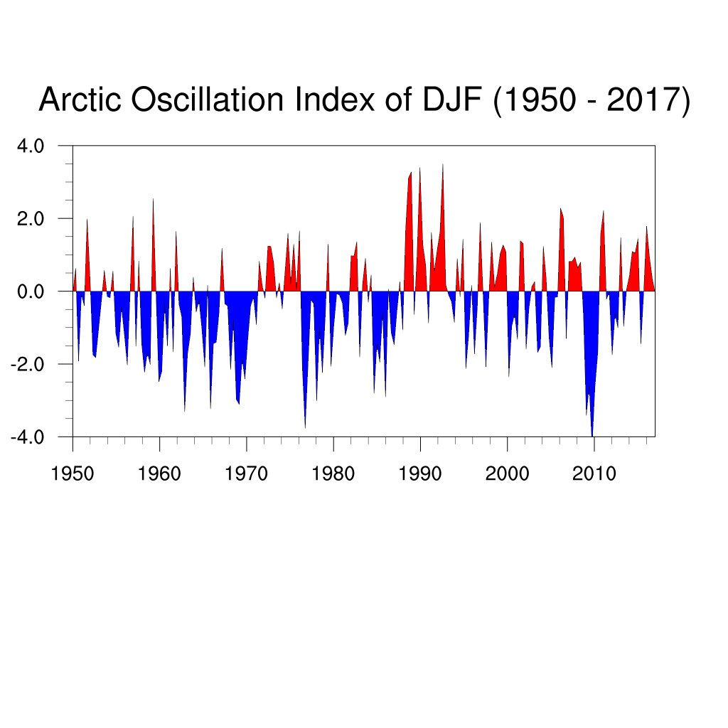
Time series
Other indices
Reference : https://climatedataguide.ucar.edu/climate-data/overview-climate-indices

Slide 25
Homework

Slide 26
Homework 2-1
Please analyze the precipitation anomalies in Nino3.4 region with the time series.
(Path: /data/course/ERA-Interim/Monthly/0.5x0.5/Inter-tropical/ Pre_T/)
(Please put your HW under /data/course/2023_NCL_course/student/your_name/hw2/)

Slide 27
Homework 2-2
Please compare the result with the time series of SSTA.
(Path: /data/course/ERA-Interim/Monthly/0.5x0.5/Global/SST/)
code
*.png or *.pdf
some analysis (word or PPT)
Deadline : 2022/03/09 14:59
(Please put your HW under /data/course/2023_NCL_course/student/your_name/hw2/)

Slide 28

FB : 蔡婉麗
 | Monday | Tuesday | Wednesday | Thursday | Friday
1
2
3
4
5 | X | ∆
6 | X | ∆
7 | X | ∆ |  |  | X
8 |  | ∆ |  |  | X

